Slide 1




Knowledge Discovery From Satellite images
  Prof. Dr. Begüm Demir
  Email: demir@tu-berlin.de
  Chair of Remote Sensing Image Analysis (RSiM) Group
  TU Berlin

Slide 2

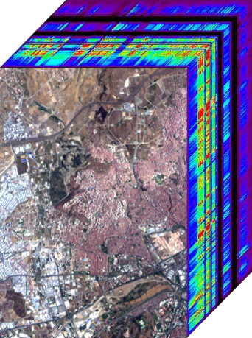
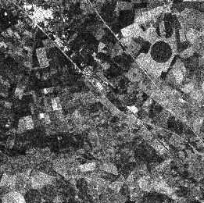
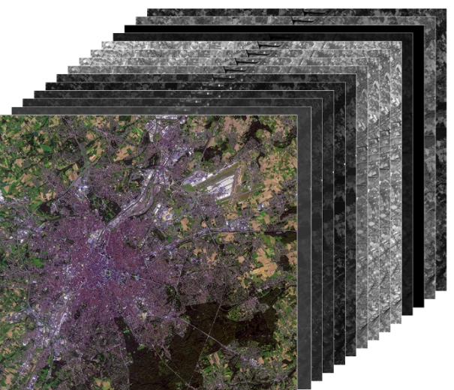
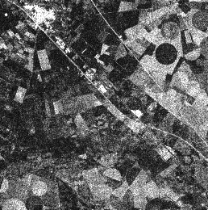
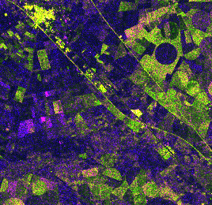

Introduction
Remote sensing (RS) images are a rich information source for monitoring the Earth surface, e.g., for climate change analysis, urban area studies, forestry applications, risk and damage assessment, water quality assessment, crop monitoring.
NASA’s EO-1
(Hyperspctral)
ESA’s Sentinel-1
(SAR)
ESA’s Sentinel-2
(Multispectral)
Fort McMurray, Canada-24/06/2016
Brussels, Belgium-08/09/2016
Ankara, Turkey-15/08/2015
B. Demir

Slide 3
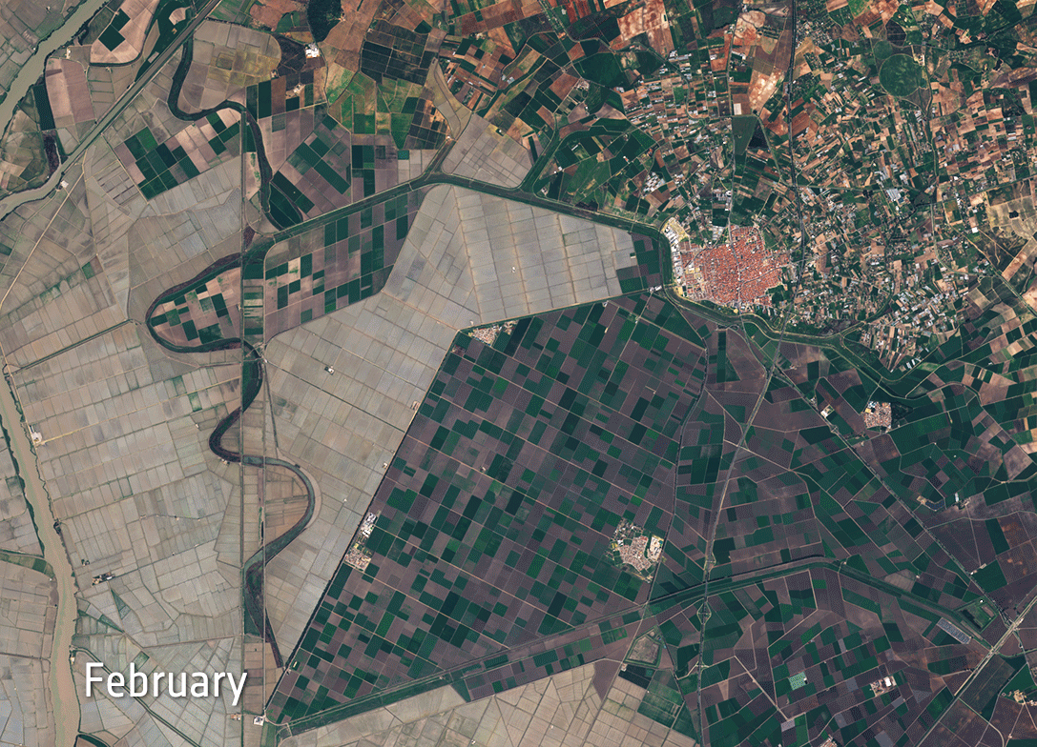
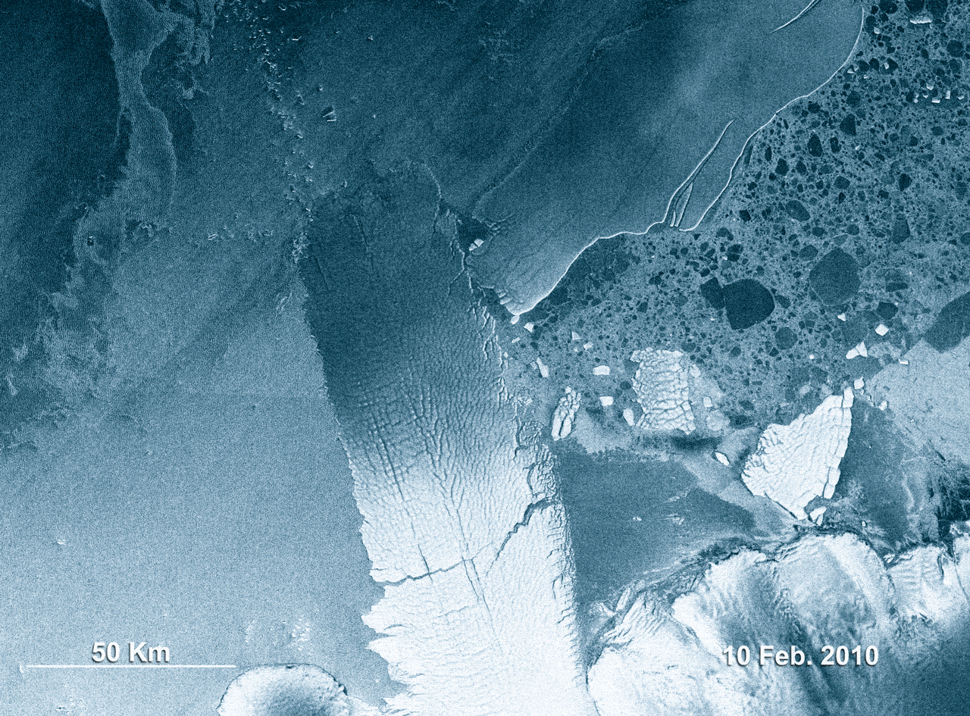
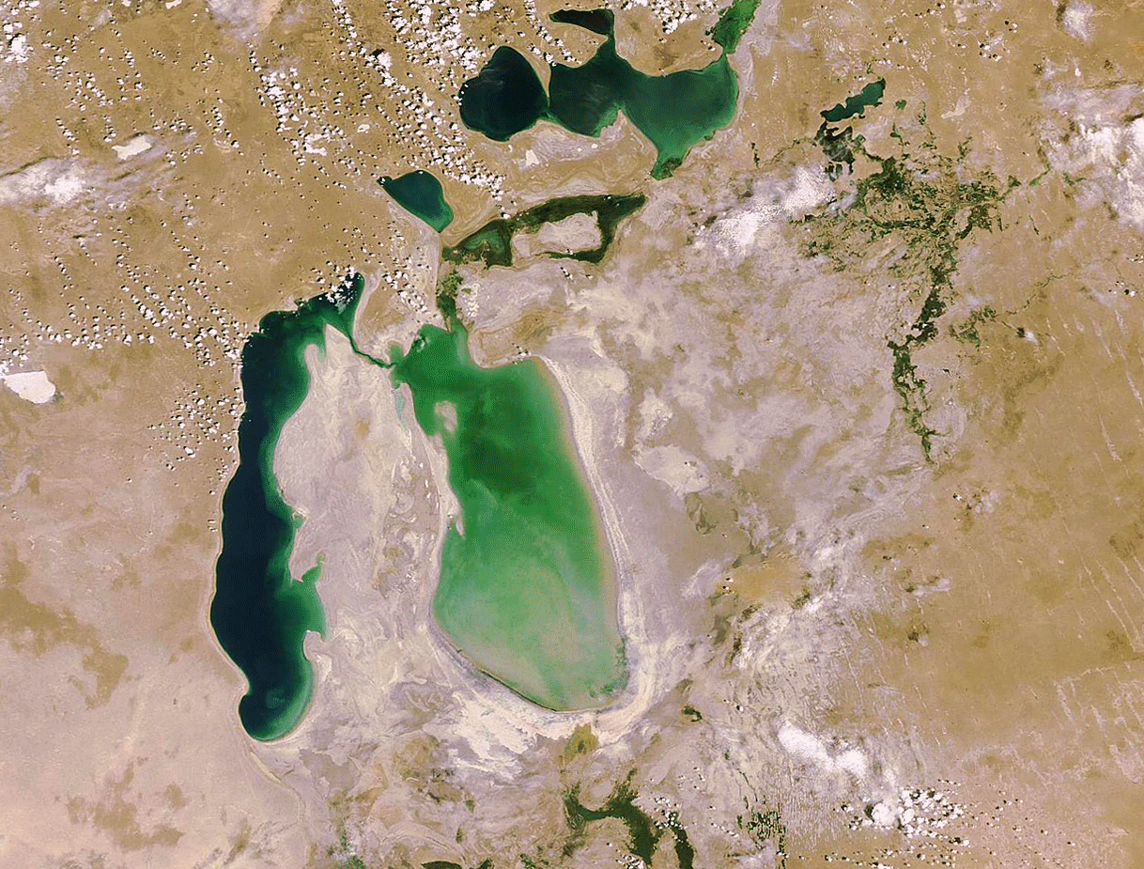
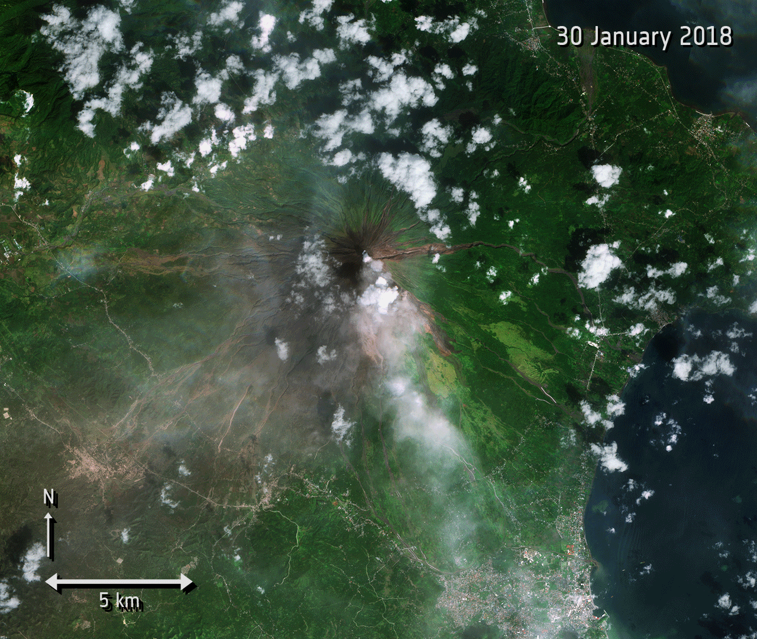
Space Renaissance
Copyright: ESA
Agricultural monitoring in Spain
Icebreaker event in Antarctica
Retreat of the Aral Sea
Mayon lava

Slide 4
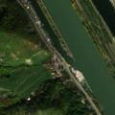
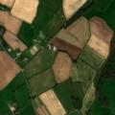
Knowledge Discovery in RS Archives
Data Archive
Feature Extraction
RS Image Classification/Search/
Retrieval
AUX
Image features
Image Archive
discontinuous urban fabric,
port areas, green urban areas,
vineyards, broad-leaved forest,
water courses, water bodies
non-irrigated arable land, fruit trees
and berry plantations,
pastures
B. Demir

Slide 5
RS Image Descriptors
RS Image Descriptors
The performance of the knowledge discovery algorithms highly depends on the capability of the RS image features in characterizing the content of the images.
Global image representations are defined based on a set of local descriptors, such as:
  Scale Invariant Feature Transform (SIFT) models portions of image around the interest points;
  Local Binary Pattern (LBP);
  Local Phase Quantization (LPQ).
To define the global image representations, the bag-of-visual-words representations of the local descriptors are considered.
[1] P. Maheswary and N. Srivastava, “Retrieval of Remote Sensing Images Using Colour & Texture Attribute,” IJCSIS Int. J. Comput. Sci. Inf. Secur., vol. 4, no. 2, pp. 1–5, 2009.
[2] P. Hong, Q. Tian, and T. S. Huang, “Incorporate support vector machines to content-based image retrieval with relevant feedback,” in Proc. IEEE Int. Conf. Image Process., Vancouver, BC, Canada, 2000, pp. 750–753.
[3] M. Musci, R. Q. Feitosa, G. A. O. P. Costa, M. Luiza, and F. Velloso, “Assessment of Binary Coding Techniques for Texture Characterization in Remote Sensing Imagery,” IEEE Geosci. Remote Sens. Lett., vol. 10, no. 6, pp. 1607–1611, 2013.
B. Demir

Slide 6
RS Image Descriptors
Region-based Descriptors: These descriptors are obtained by segmenting the images and each segments are represented using various features such as:
  Intensity;
  Shape;
  Texture.
Hashing based image descriptors: Represent each image with binary code vectors.
[1] B. Chaudhuri, B. Demir, S. Member, and L. Bruzzone, “Region-Based Retrieval of Remote Sensing Images Using an Unsupervised Graph-Theoretic Approach,” vol. 13, no. 7, pp. 987–991, 2016.
[2] B. Demir and L. Bruzzone, “A Novel Active Learning Method in Relevance Feedback for Content-Based Remote Sensing Image Retrieval,” IEEE Trans. Geosci. Remote Sens., vol. 53, no. 5, pp. 2323–2334, 2015.
[3] B. Demir, L. Bruzzone, "Hashing Based Scalable Remote Sensing Image Search and Retrieval in Large Archives", IEEE Transactions on Geoscience and Remote Sensing, vol. 54, no.2, pp. 892-904, 2016.
B. Demir

Slide 7
Histogram-based features
Spectral histograms model each pixel by considering marginal distributions of responses of a bank of filters based on three steps:
Step-1: Apply a sequence of filters to the RS image
X
Image
Step-2: Estimate local histograms of each sample at the j-th pixel location in images in a w×w window
Step-3: Stack the local histograms to obtain the Spectral Histogram
J. Yuan, D. Wang, R. Li, “Remote sensing image segmentation by combining spectral and texture features”, IEEE Transactions on Geoscience and Remote Sensing, vol. 52, no. 1, pp.16-24, Jan. 2014.
B. Demir

Slide 8
Scale Invariant Feature Transform
Scale-invariant feature transform (or SIFT) is an algorithm to detect and describe local features in images.
  Distinctive features;
  Invariant to image scale, rotation and affine distortion;
  Applied locally on key-points;
  Based upon the image gradients in a local neighborhood.
SIFT is in wide use both in academia and industry
Many available implementations:
  Binaries available at Lowe’s website;
  C/C++ open source by A. Vedaldi (UCLA);
  C# library by S. Nowozin (TU-Berlin).
Lowe, D. G., “Distinctive Image Features from Scale-Invariant Keypoints”, International Journal of Computer Vision, 60, 2, pp. 91-110, 2004.
B. Demir

Slide 9
Scale Invariant Feature Transform
SIFT has 4 main steps:
  Scale-space extrema detection
  Keypoint localization
  Orientation assignment
  Keypoint descriptor
SIFT key locations are defined as maxima and minima of the result of difference of Gaussians function applied in scale space to a series of smoothed and resampled images.
Bag-of-visual-words approach is used for SIFT to model the final feature vector of an image. Thus, the final representation is the frequency or histogram of the codewords in an image.
B. Demir

Slide 10
Local Binary Patterns
LBP represents the relationship of each pattern (i.e., pixel) in a given image with its neighbors located on a circle around that pixel by a binary code. The success of LBP is due to:
  its easy implementation and low computational complexity;
  its invariance to monotonic illumination changes.
B. Demir

Slide 11
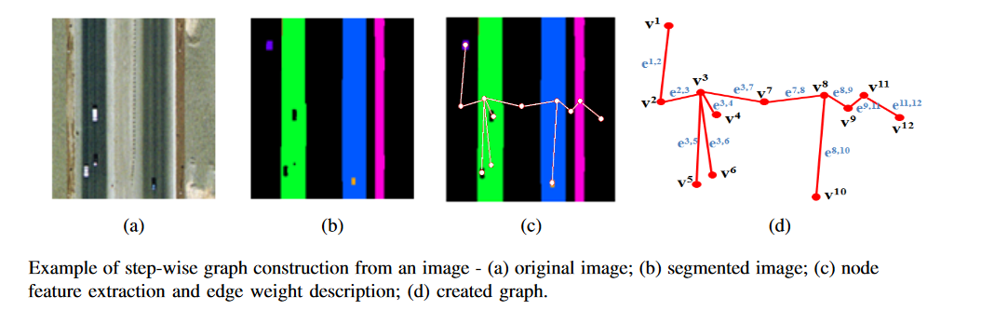
Region Based Descriptors
Shape features (which include Fourier descriptors and contour-based shape descriptors like area, convex area, perimeter, extent, solidity and eccentricity derived from the region contours);
Intensity features (which consist of the mean, standard deviation and skewness of the samples within each region in each spectral channel);
Texture features (which include entropy and spectral histogram).
B. Demir

Slide 12
Region Based Descriptors
The similarities between the query graph and the graphs of images in the archive are calculated using a novel inexact graph matching strategy that jointly consists of:
  a subgraph isomorphism algorithm (which measures the similarity between graph nodes);
  a spectral embedding algorithm (which measures the similarity between graph edges).
B. Chaudhuri, B. Demir, L. Bruzzone, S. Chaudhuri, "Region-Based Retrieval of Remote Sensing Images using an Unsupervised Graph-Theoretic Approach", IEEE Geoscience and Remote Sensing Letters, vol. 13, no.7, pp. 987-991, 2016.
B. Demir

Slide 13

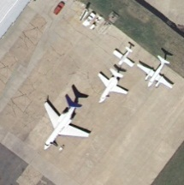
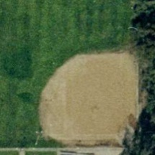
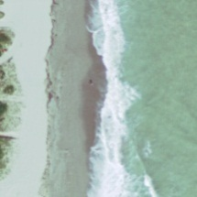
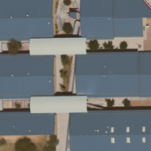
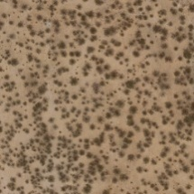
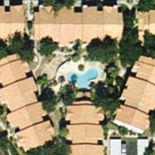
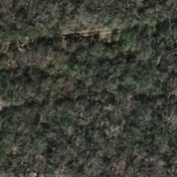
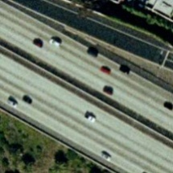
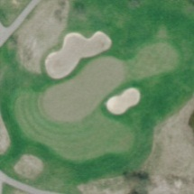
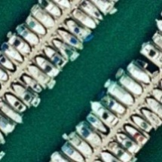
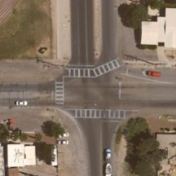
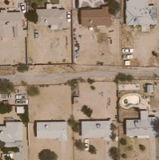
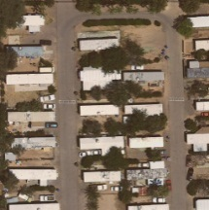
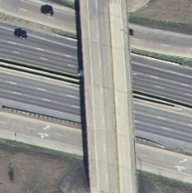
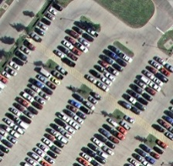
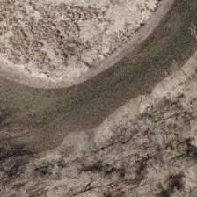
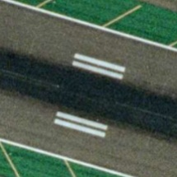
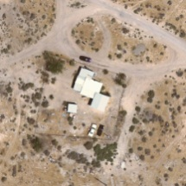
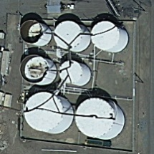
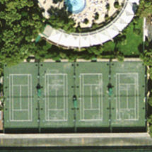
Data Set Description
Data Set Description
Data set: archive that consists of annotated images associated with 21 categories selected from aerial orthophotos with a pixel resolution of 30 cm. Each class includes 100 images that were downloaded from the USGS National Map of several US regions.
agriculture
airplanes
baseball dia.
beach
buildings
chaparral
dense-res.
forest
freeway
golf course
harbor
intersection
medium-res.
mobile-home
overpass
sparse-res.
stor. tanks
parking lot
river
runway
tennis courts
Y. Yang, and S. Newsam, “Geographic image retrieval using local invariant features”, IEEE Transactions on Geoscience and Remote Sensing, vol. 51, no. 2, pp. 818-832, Feb. 2013.
B. Demir

Slide 14
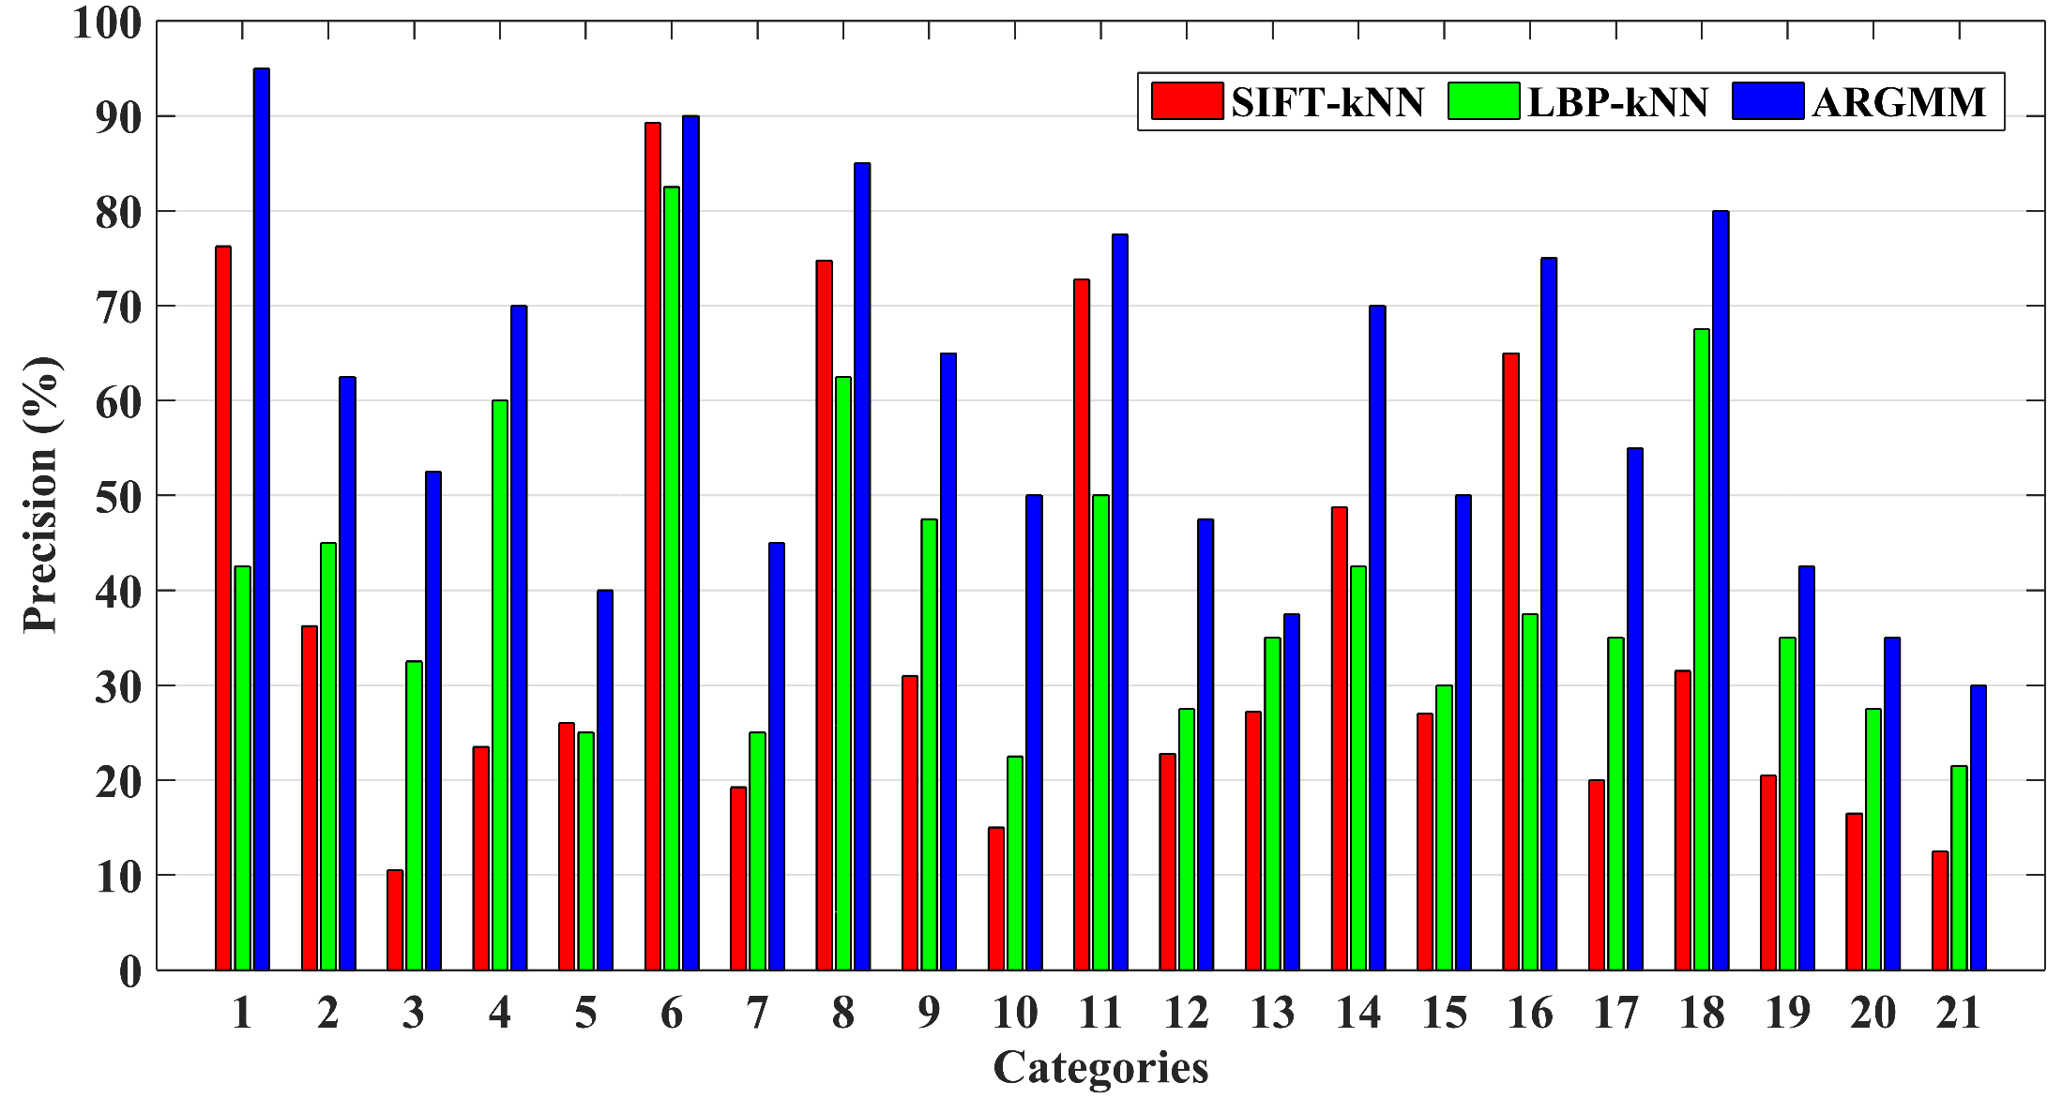
Desciptors Comparison
B. Demir

Slide 15
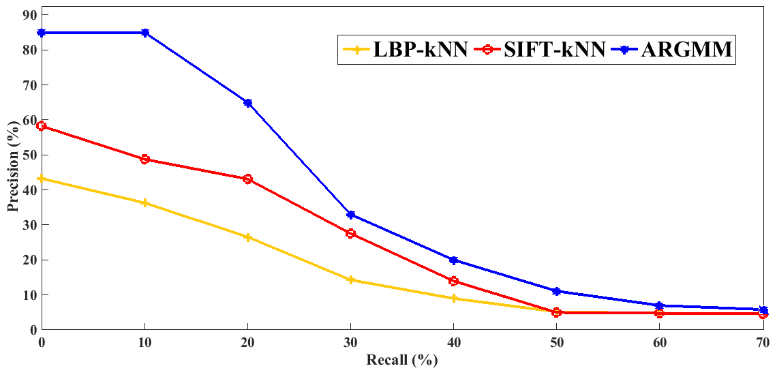
Desciptors Comparison
B. Demir

Slide 16
RS Image Classification
Many techniques have been presented in the literature for the classification of RS images, such as:
  maximum likelihood (ML) classifier;
  k-nearest neighbor classifier;
  decision trees, genetic algorithms based classifiers;
  artificial neural networks (multilayer perceptrons, radial basis function neural networks);
  kernel-based methods (i.e., regularized radial basis function neural networks, support vector machine);
  graph matching algorithms.
L. Bruzzone, B. Demir, "A Review of Modern Approaches to Classification of Remote Sensing Data, in Land Use and Land Cover Mapping Europe, Practices and Trends", Eds: I. Manakos, M. Braun, EARSeL Book Series, Springer Verlag, Chapter 9, 2014, pp. 127-143
B. Demir

Slide 17
Deep Networks in Remote Sensing
Recent advances in deep learning have attracted great attention in RS due to high capability of deep networks to model high-level semantic content of RS images.
Examples of deep networks:
  Convolutional Neural Network;
  Recurrent Neural Networks;
  Generative Adversarial Networks.
P. Helber, B. Bischke, A. Dengel, and D. Borth, “EuroSAT:A novel dataset and deep learning benchmark for land use and land cover classiﬁcation,” arXiv preprint arXiv:1709.00029, 2017.
B. Demir

Slide 18
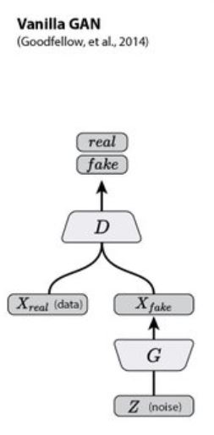
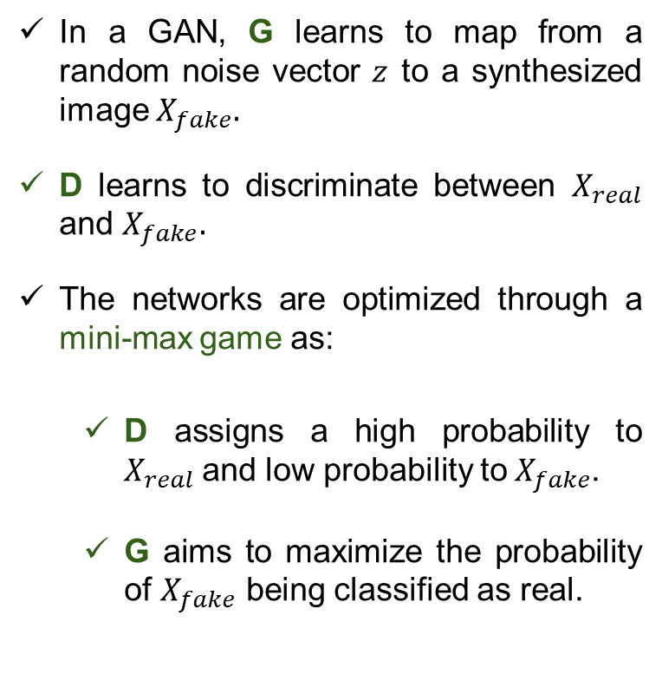
Deep Features: Generative Adversarial Network (GAN)
In a GAN, G learns to map from a random noise vector $z$ to a synthesized image $X_{fake}.$
D learns to discriminate between $X_{real}$ and $X_{fake}.$
The networks are optimized through a mini-max game as:
  D assigns a high probability to $X_{real}$and low probability to${ X}_{fake}$.
  G aims to maximize the probability of $X_{fake}$ being classified as real.
B. Demir

Slide 19
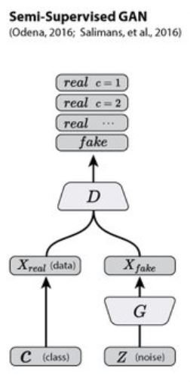
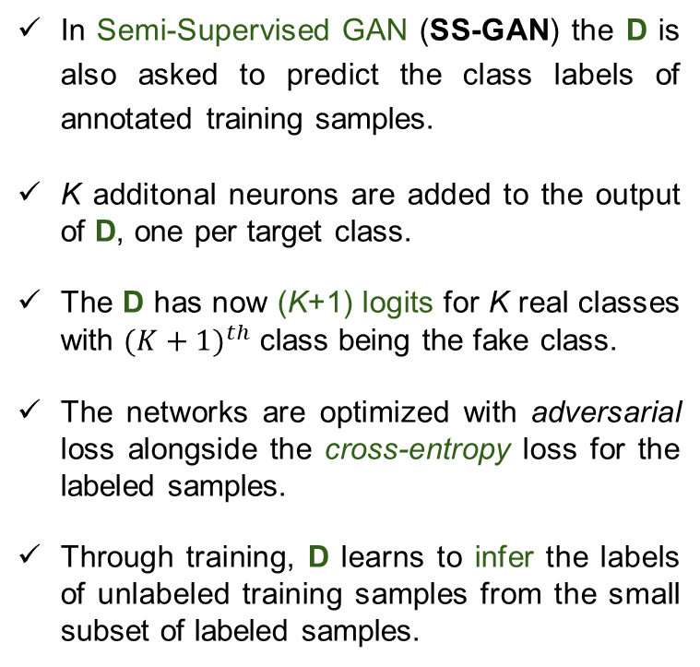
Semi-Supervised GAN
In Semi-Supervised GAN (SS-GAN) the D is also asked to predict the class labels of annotated training samples.
K additonal neurons are added to the output of D, one per target class.
The D has now (K+1) logits for K real classes with ${(K+1)}^{th}$ class being the fake class.
The networks are optimized with adversarial loss alongside the cross-entropy loss for the labeled samples.
Through training, D learns to infer the labels of unlabeled training samples from the small subset of labeled samples.
Salimans, Tim, et al. "Improved techniques for training GANs," Advances in Neural Information Processing Systems. 2016.
B. Demir

Slide 20
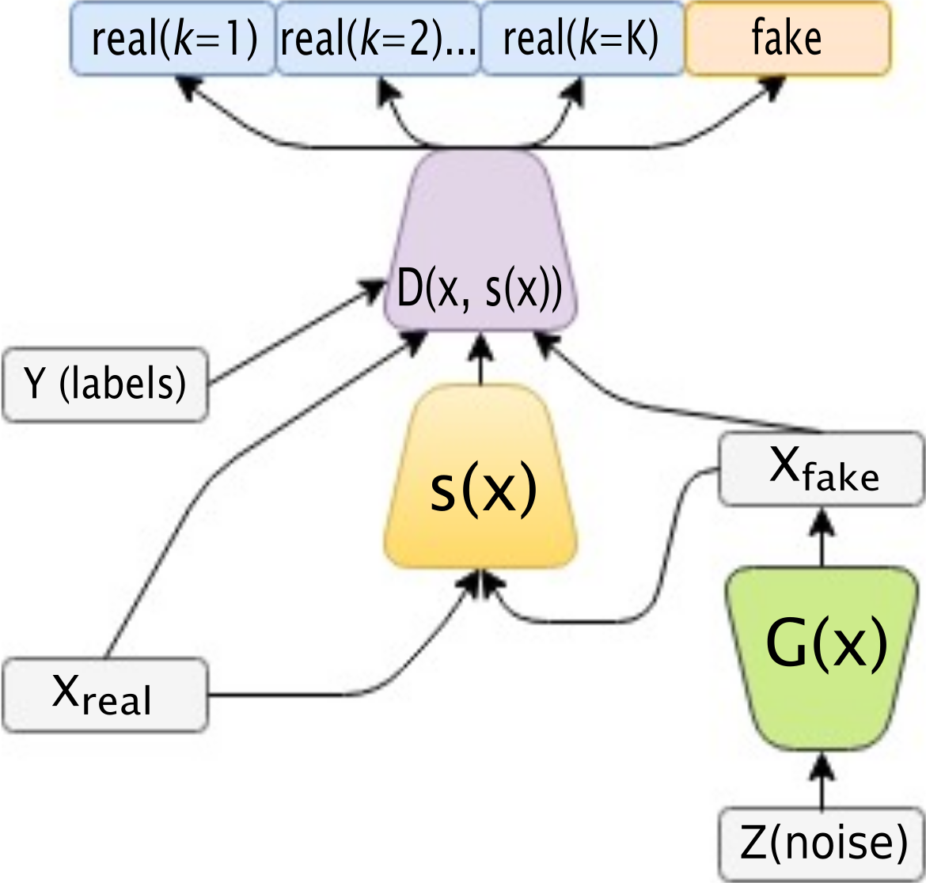
Our Semantic-Fusion GAN
Main idea: Enrich image representation fed to D using visual semantics.
An external network is used to extract generic visual information from the satellite images.
Intuitively, the high-level feature representation of the input from the external ‘channel’ allows the D to learn a more robust classifier.
B. Demir

Slide 21
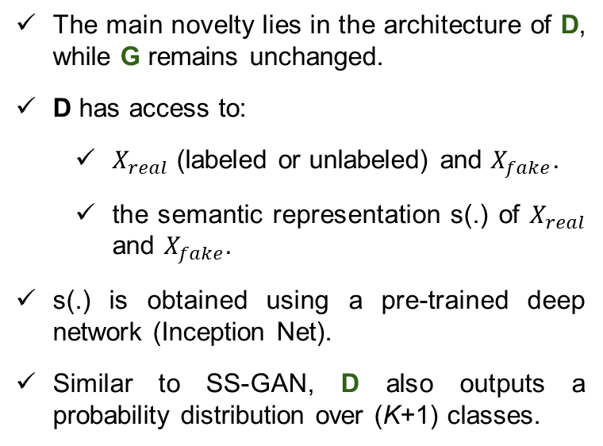
Our Semantic-Fusion GAN
The main novelty lies in the architecture of D, while G remains unchanged.
D has access to:
  $X_{real}$ (labeled or unlabeled) and $X_{fake}.$
  the semantic representation s(.) of $X_{real}$ and $X_{fake}.$
s(.) is obtained using a pre-trained deep network (Inception Net).
Similar to SS-GAN, D also outputs a probability distribution over (K+1) classes.
S. Roy, E. Sangineto, B. Demir, N. Sebe, "Semantic-Fusion GANs for Semi-Supervised Satellite Image Classification", International Conference on Image Processing, Athens, Greece, 2018.
B. Demir

Slide 22
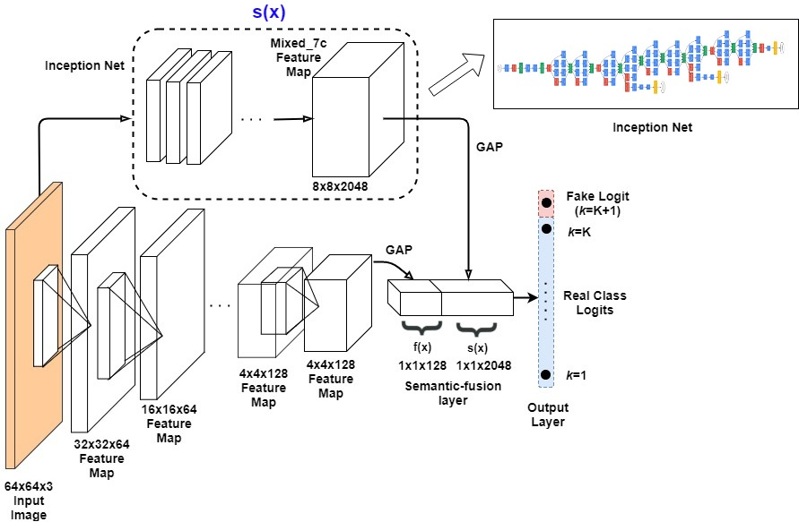

Discriminator Architecture of SF-GAN
s(x)
s(.) are the activations from
the last but one layer (${Mixed}_{7c})$
of Inception Net having
8 $×8×2048$
feature maps.
B. Demir

Slide 23
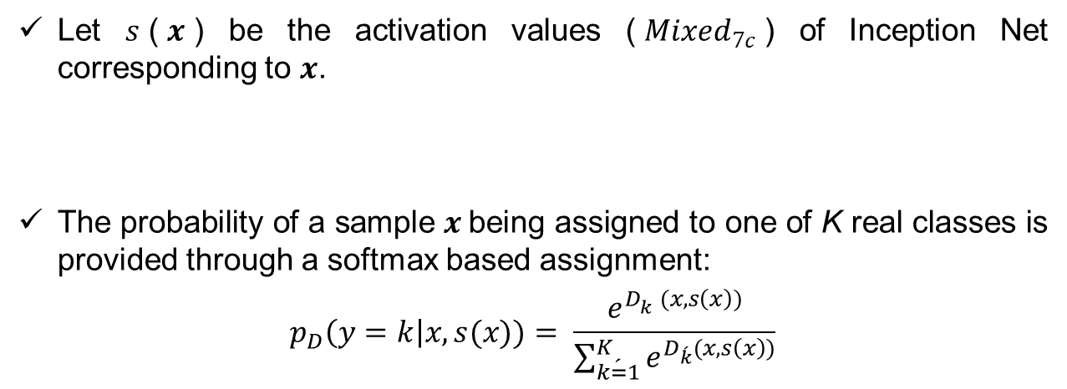
Objective Formulation of SF-GAN
Let $s$($x$) be the activation values (${Mixed}_{7c}$) of Inception Net corresponding to $x$.
The probability of a sample $x$being assigned to one of K real classes is provided through a softmax based assignment:
$$p_{D}\left(y=k\right|x, s(x))= \frac{e^{D_{k}^{}(x, s\left(x\right))}}{\sum_{\acute{k=1}}^{K}{e^{D_{\acute{k}}(x, s\left(x\right))}}}$$
B. Demir

Slide 24
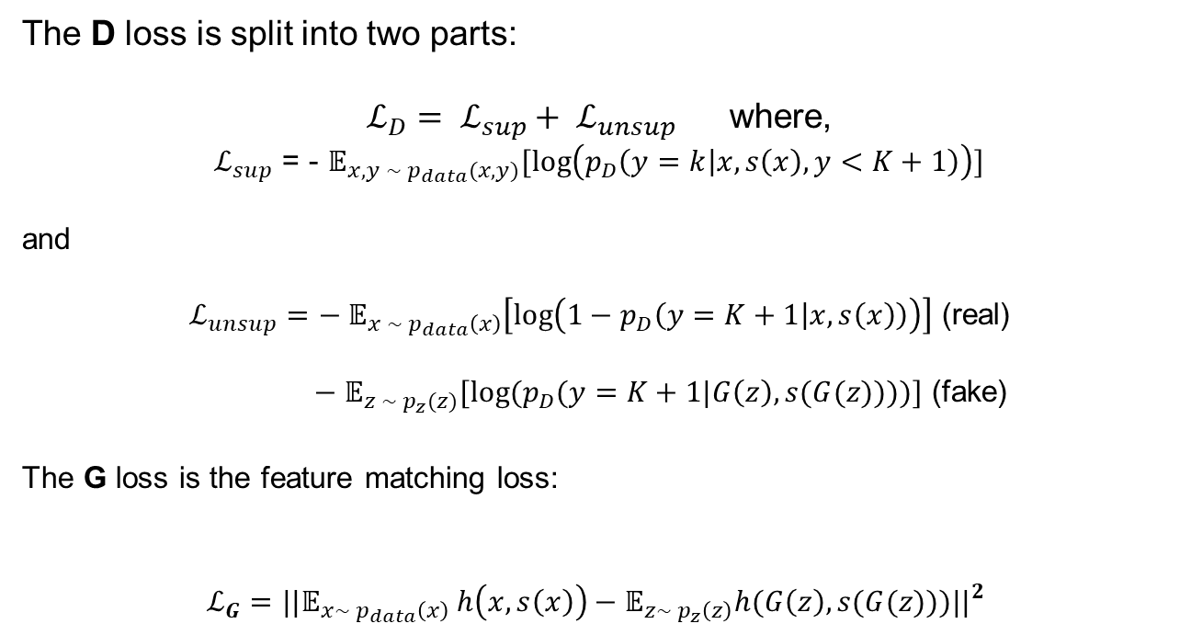
Objective Formulation of SF-GAN
The D loss is split into two parts:
$ℒ_{D}= ℒ_{sup}+ ℒ_{unsup}$where,
$ℒ_{sup}$ = - $𝔼_{x, y ∼ p_{data}(x, y)}[log\left(p_{D}\left(y=k | x, s\left(x\right), y<K+1\right)\right)]$
and
$ℒ_{unsup}=− 𝔼_{x ∼ p_{data}\left(x\right)}\left[\log\left(1−p_{D}\left(y=K+1 | x, s\left(x\right)\right)\right)\right]$ (real)
$− 𝔼_{z ∼ p_{z}(z)}[log⁡(p_{D}(y=K+1|G\left(z\right), s(G(z))))]$ (fake)
The G loss is the feature matching loss:
$$ℒ_{G}={||𝔼_{x∼ p_{data}\left(x\right)} h\left(x, s\left(x\right)\right)−𝔼_{z∼ p_{z}\left(z\right)}h(G\left(z\right),s(G(z)))||}_{}^{2}$$
B. Demir

Slide 25
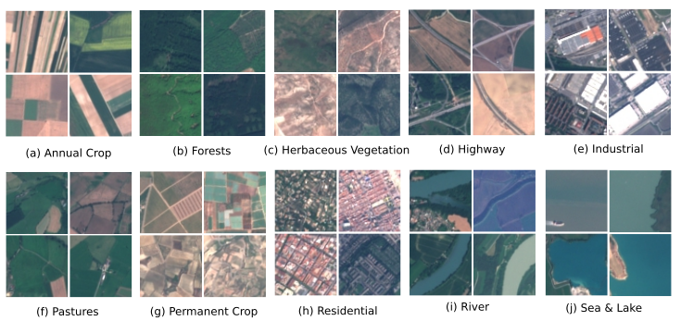
Dataset Description
Archive: EuroSAT archive which consists of 27000 annotated Sentinel-2 RS images
B. Demir

Slide 26
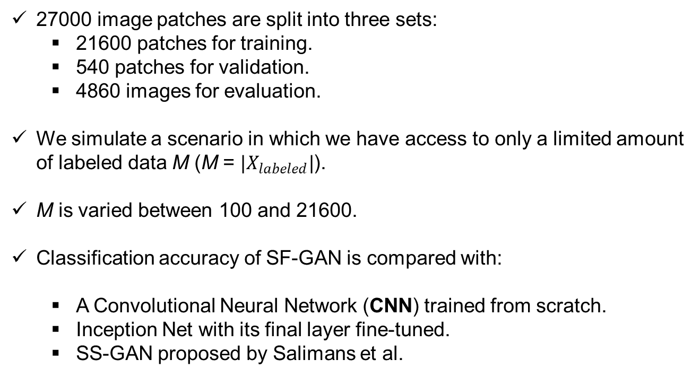
Design of Experiments
27000 image patches are split into three sets:
  21600 patches for training.
  540 patches for validation.
  4860 images for evaluation.
We simulate a scenario in which we have access to only a limited amount of labeled data M (M = $|X_{labeled}|$).
M is varied between 100 and 21600.
Classification accuracy of SF-GAN is compared with:
  A Convolutional Neural Network (CNN) trained from scratch.
  Inception Net with its final layer fine-tuned.
  SS-GAN proposed by Salimans et al.
B. Demir

Slide 27
Experimental Results
Method | Training Regime | # of labels M
 |  | 100 | 1000 | 2000
CNN (from scratch) | Supervised | 29.3% | 46.1% | 59.0%
Inception Net (fine-tuned) | Supervised | 63.9% | 84.6% | 87.9%
SS-GAN | Semi- Supervised | 63.0% | 75.8% | 78.3%
Our SF-GAN | Semi- Supervised | 68.6% | 86.1% | 89.0%
B. Demir

Slide 28
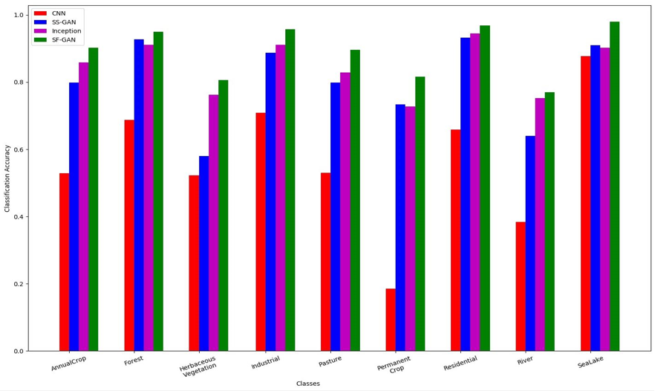
Experimental Results
Classwise classification accuracy obtained when M=100.
B. Demir

Slide 29
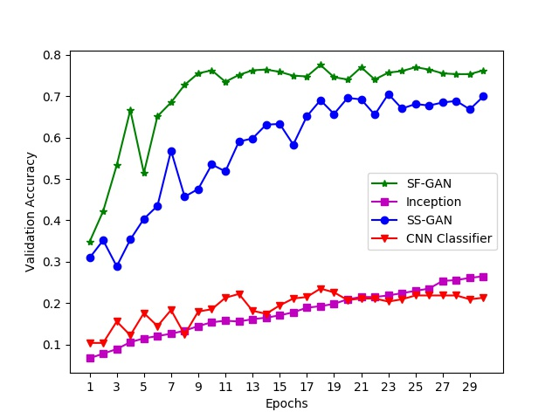
Experimental Results
Validation accuracy over different training epochs with M = 100.
B. Demir

Slide 30
Existing Benchmark Archives in Remote Sensing
Name | # of classes | # of images | Image Size | Spatial Resolution
UCMerced | 21 | 2100 | 256 x 256 | 30cm
AID | 30 | 10000 | 600 x 600 | 8 m to 0.5 m
WHU-RS19 | 19 | 1005 | 600 x 600 | up to 0.5 m
SIRI-WHU | 12 | 2400 | 200 x 200 | 2 m
RSSCN7 | 7 | 2800 | 400 x 400 | variations
RSC11 | 11 | 1232 | 512 x 512 | 0.2m
NWPU-RESISC45 | 45 | 31500 | 256 x 256 | 30 m to 0.2 m
EuroSat | 10 | 27000 | 64 x 64 | 10m to 60 m
B. Demir

Slide 31
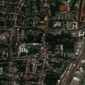
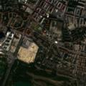






BigEarthNET: A NEW LARGE-SCALE
SENTINEL-2 BENCHMARK ARCHIVE
The archive, named BigEarthNet, consists of 590,326 Sentinel-2 image patches that are accompanied by multiple annotations.
http://bigearth.eu/
Coming Soon Online!
B. Demir

