Slide 1




Content Based Retrieval of
Remote Sensing Images
  Prof. Dr. Begüm Demir
  Email: demir@tu-berlin.de
  Chair of Remote Sensing Image Analysis (RSiM) Group
  TU Berlin

Slide 2

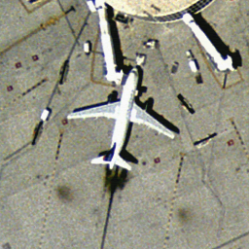
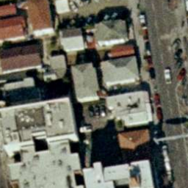
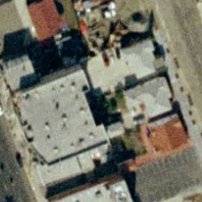
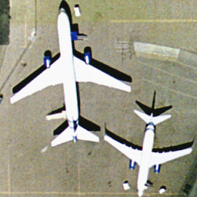
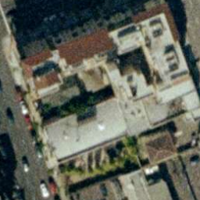
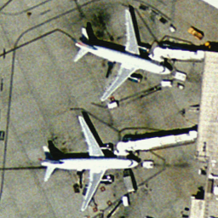
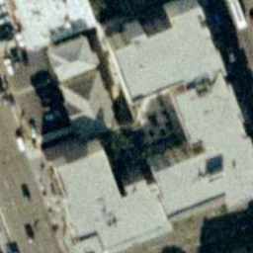
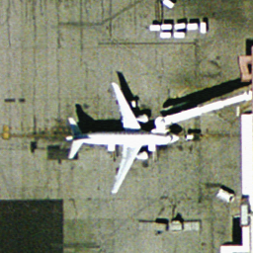

CBIR in RS: General Approach
Feature Extraction
Image
features
Query Image
RS Image Retrieval
Data Archive
Feature Extraction
Image
features
AUX
Image Archive
Retrieved Images
Search complexity is O(n) and storage complexity is O(nd), where n is number of images in the archive and d is the image feature number.
CBIR becomes computationally time-demanding when the number of images n in the archive is very large.
  Problem: exhaustive search in huge remote sensing archives is difficult with available algorithms.
B. Demir

Slide 3
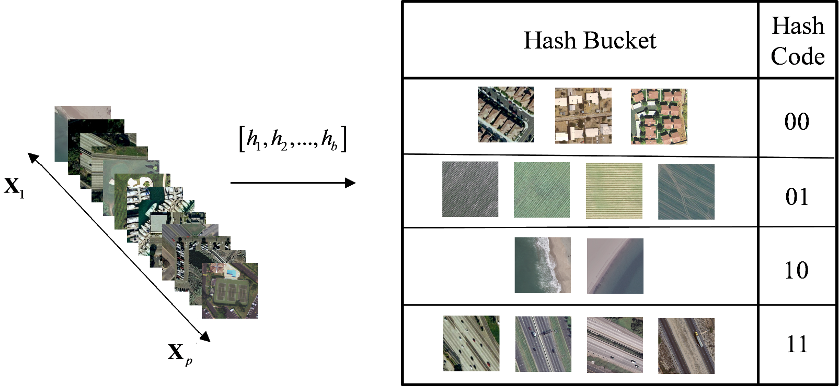
Hashing Methods in Image Retrieval
Hashing Methods in Image Retrieval
Hash functions
P-th image
in the archive
B. Demir, L. Bruzzone “Hashing based scalable remote sensing image search and retrieval in large archives”, IEEE Transactions on Geoscience and Remote Sensing, vol. 54, no.2, pp. 892-904, 2016.
B. Demir

Slide 4
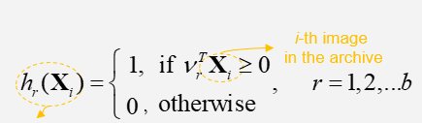
Hashing Methods in Image Retrieval
Locality Sensitive Hashing (LSH): popular unsupervised hashing method that takes random projections of data and quantizes each projection with few bits.
Hash function of the LSH method:
is a random vector generated from a multivariate Gaussian (with zero mean and identity covariance matrix) of the same dimension as the input
r-th hash
function
0
1
0
Query image
Qualitative Example for the case of b is 3
1
0
1
B. Demir

Slide 5
Kernel-based Hashing Methods
Two main methods that define hash functions in the kernel space:
  kernel-based unsupervised LSH hashing method (hash functions are defined by using only unlabeled images) [1].
  kernel-based supervised hashing LSH method (semantic similarity is used to define much distinctive hash functions) [2].
Kernel-based methods express the Gaussian random vector as the weighted sum of m images selected from the archive as:
Then the hash function becomes:
nonlinear mapping function
r-th hash
function
kernel
function
[1] B. Kulis and K. Grauman, “Kernelized locality-sensitive hashing,” IEEE Transactions on Pattern Analysis and Machine Intelligence, vol. 34, no. 6, pp. 1092 – 1104, 2012.
[2] W. Liu, J. Wang, R. Ji, Y.-G. Jiang, and S.-F. Chang, “Supervised hashing with kernels”, Conference on Computer Vision and Pattern Recognition, Rhode Island, USA, 2012.
B. Demir

Slide 6
Unsupervised Kernel-Based LSH
The KULSH method extends the LSH method to non-linearly separable data by modeling each hash function as a non-linear kernel hyperplane constructed from unlabeled data.
KULSH method constructs random projections using kernel functions on the basis of the following steps:
  selecting a small set of m images from the archive itself and form a kernel matrix on this data;
  estimate the Eigen-decomposition of
  calculate the vector
Then, r-th hash function in the KULSH method is defined as:
The KULSH method is very fast at generating hash functions. However, because it does not use labeled images, the obtained hash functions may not be distinctive enough for complex RS image retrieval problems.
a vector with ones corresponding to the indices of subset of m samples
B. Kulis and K. Grauman, “Kernelized locality-sensitive hashing,” IEEE Transactions on Pattern Analysis and Machine Intelligence, vol. 34, no. 6, pp. 1092 – 1104, 2012.
B. Demir

Slide 7
Supervised Kernel-Based LSH
Let us assume that a labeled training set made up of l annotated images is available.
The supervised KSLSH method defines hash functions such that:
  hamming distances from similar images are minimized and those from dissimilar images are maximized.
  the same hash bits for similar images are generated while obtaining different hash bits for dissimilar images.
A pairwise label matrix that shows similarity of image pairs in labeled training set is generated:
The hamming distances between images in and the labels in are correlated.
B. Demir

Slide 8
Supervised Kernel-Based LSH
The hash code matrix that includes the hash codes of all training images is constructed :
In order to learn the hash codes of the l labeled images in the following optimization problem is defined:
After substituting in the optimization function, we obtain the analytical form of the objective function:
Greedy optimization algorithm based on spectral relaxation and sigmoid smoothing is used.
frobenius norm
kernel similarity matrix between
m selected samples and the l-labeled training samples
B. Demir

Slide 9
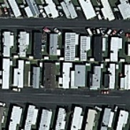
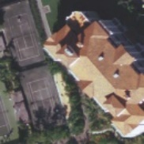

Pros and Cons
  These hashing methods are promising in RS for CBIR problems as they allow sub-linear time approximate similarity search with a good retrieval accuracy.
Query
Images in the Archive
features
features
features
1 1 1 0 0
1 0 1 0 1
0 1 1 0 1
Problem: Representing a RS image with a vector of hand-crafted features, thus with a single hash code, may result in insufficient retrieval results, particularly when high-level semantic content is present in the query images.
B. Demir

Slide 10
Multi-Code Hashing
Aim: Develop hashing methods that accurately model the primitives in the definition of hashing functions.
Recent solutions: Define semantic-sensitive hashing methods:
  cluster sensitive multi-code hashing method (is unsupervised and thus does not require any annotated images).
  class sensitive multi-code hashing method (is supervised a small set of annotated images with region labels is available.
  metric learning based deep hashing network.

Slide 11
Multi-Code Hashing
STEP 1
STEP 2
Characterize images by descriptors of primitives
Transform the descriptors to multi-hash codes
Retrieve Images based on multi-hash codes
Characterize query image by descriptors of primitives
Transform the descriptors to multi-hash codes
T. Reato, B. Demir, L. Bruzzone, "A Novel Unsupervised Multi-Code Hashing Strategy for Accurate and Scalable Remote Sensing Image Retrieval", IEEE Geoscience and Remote Sensing Letters, accepted for publication.
B. Demir

Slide 12
Unsupervised Multi-Code Hashing: Step 1
Extract image regions through segmentation
Compute regions’ descriptors for each image
Each region is described by:
shape features;
texture features;
intensity features.
Any segmentation algorithm can be used, whereas in this work we have considered the parametric kernel graphs cuts algorithm.
M. Ben Salah, A. Mitiche, and I. B. Ayed, “Multiregion image segmentation by parametric kernel graph cuts,” IEEE Transactions on Image Processing, vol. 20, no. 2, pp. 545–557, 2011.
B. Demir

Slide 13
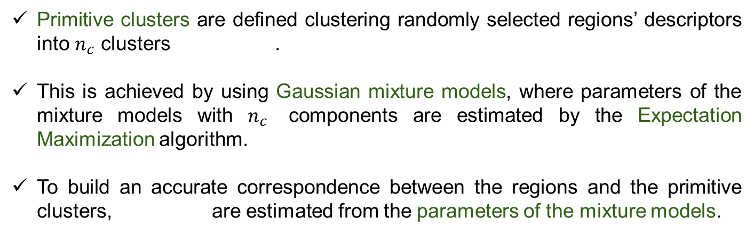
Unsupervised Multi-Code Hashing: Step 1
Extract image regions through segmentation
Compute regions’ descriptors for each image
Construct primitive clusters
Estimate region posterior probabilities
Primitive clusters are defined clustering randomly selected regions’ descriptors into $n_{c}$ clusters .
This is achieved by using Gaussian mixture models, where parameters of the mixture models with $n_{c}$ components are estimated by the Expectation Maximization algorithm.
To build an accurate correspondence between the regions and the primitive clusters, are estimated from the parameters of the mixture models.
B. Demir
16

Slide 14
Unsupervised Multi-Code Hashing: Step 1
Extract image regions through segmentation
Compute regions’ descriptors for each image
Construct primitive clusters
Generate descriptors of primitives
Estimate region posterior probabilities
Descriptors of primitives are estimated as follows:
threshold
k-th class
k-th posterior probability
vector of all zero entries
B. Demir

Slide 15
Multi-Code Hashing: Step 2
Hashing is applied to the descriptors of each primitive cluster separately from each other.
Kernel-based unsupervised locality sensitive hashing (KULSH) is applied to the descriptors of k-th primitive class separately from each other.
The same process is applied for a total of b hash functions , resulting in a b-bits hash code associated to each primitive class.
B. Demir, L. Bruzzone “Hashing based scalable remote sensing image search and retrieval in large archives”, IEEE Transactions on Geoscience and Remote Sensing, vol. 54, no.2, pp. 892-904, 2016.
B. Demir

Slide 16

Multi-Hash-Code-Matching
Multi-hash-code-matching scheme is used by the proposed hashing method for image retrieval.
This scheme estimates the similarity between as a sum of Hamming distances estimated between as:
Then, the images with the lowest distance are retrieved.
$$H_{C_{k}}^{X_{i}},k=1,2,...,n_{n}$$
k-th hash
code of the query image
XOR operator
k-th hash
code of the archive image
B. Demir

Slide 17
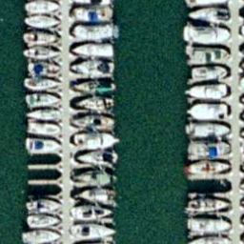
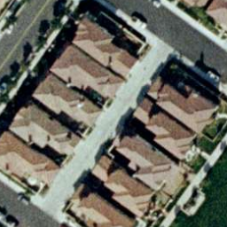
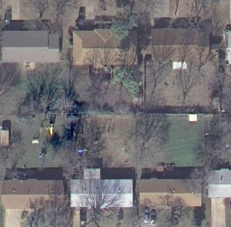
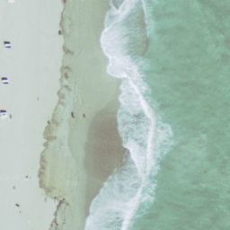
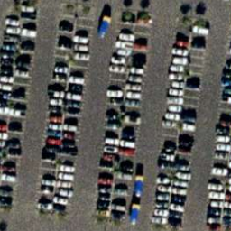
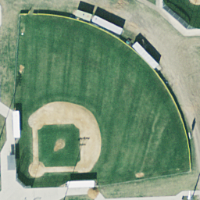
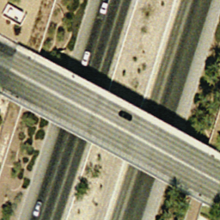
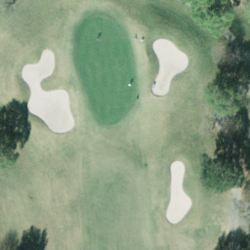
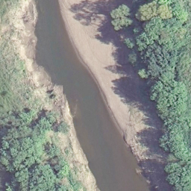
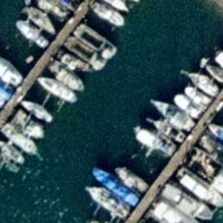
Archive Description
Data set: UCMERCED archive which consists of 2100 annotated aerial images, each of which associated with multiple labels.
dock, ship, water
buildings, cars, grass, pavement, trees
buildings, cars, grass, pavement, trees
sand, sea
cars, pavement, trees
bare soil, buildings, grass, pavement
pavement, cars,
bare soil, trees
bare soil, grass, trees
water, trees
bare soil
ship, dock, water
Download the labels: http://bigearth.eu/datasets.html
B. Demir

Slide 18
Experimental Results
Method |  | Recall | Time (in seconds) | Storage Complexity
Unsupervised | k-nn | 66.29 % |  | 1.640 KB
 | single-code hashing | 58.74 % |  | 0.033 KB
 | multi-code hashing | 65.29 % |  | 0.068 KB
Supervised | ML-SVM | 71.93 % |  | 1.640 KB
 | single-code hashing | 59.20 % |  | 0.053 KB
 | multi-code hashing | 69.05 % |  | 0.068 KB
All the experiments are implemented via MATLAB® on a standard PC with Intel® Xeon® CPU E5-1650 v2 @ 3.50GHz, 16GB RAM
B. Demir

Slide 19
Experimental Results
Standard Single-Code Hashing method
2nd
5th
16th
Query Image
buildings, cars, grass,
pavement, trees
buildings, cars,
pavement
pavement, sand
2nd
5th
16th
building, pavement
buildings, pavement
buildings, cars, grass,
pavement, trees
bare-soil, buildings, cars,
pavement, trees
Multi-Code Hashing method
B. Demir

Slide 20
Experimental Results
Unsupervised Multi-Code Hashing Method
2nd
14th
20th
Query Image
cars, pavement, trees
baresoil, cars,
pavement
dock, ship, water
2nd
14th
20th
car, pavement, trees
car, pavement
cars, pavement
cars, pavement
Supervised Multi-Code Hashing Method

Slide 21
Pros and Cons
  The multi-code hashing method is promising for RS CBIR problems since it:
    efficiently describes the complex content of RS images with multi-hash codes;
    achieves fast and scalable image search and retrieval;
    overcomes the limitations of the single hash codes.
  Kernel based-hashing methods in general learn hash functions in the kernel space from hand-crafted features (e.g., the bag-of-visual-words based on the scale invariant feature transform) are applied to RS CBIR problems.
  However, hand-crafted features may not accurately represent the high level semantic content of RS images. This leads to inaccurate retrieval results under complex RS image retrieval tasks.
B. Demir

Slide 22
Metric Learning based Deep Hashing
B. Demir

Slide 23
Metric Learning based Deep Hashing
The intuition behind the triplet loss: after training, a positive sample is “moved” closer to the anchor sample than the negative samples of the other classes.
B. Demir

Slide 24
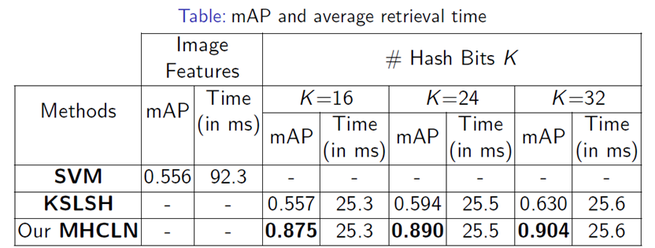
Experimental Results
B. Demir

Slide 25
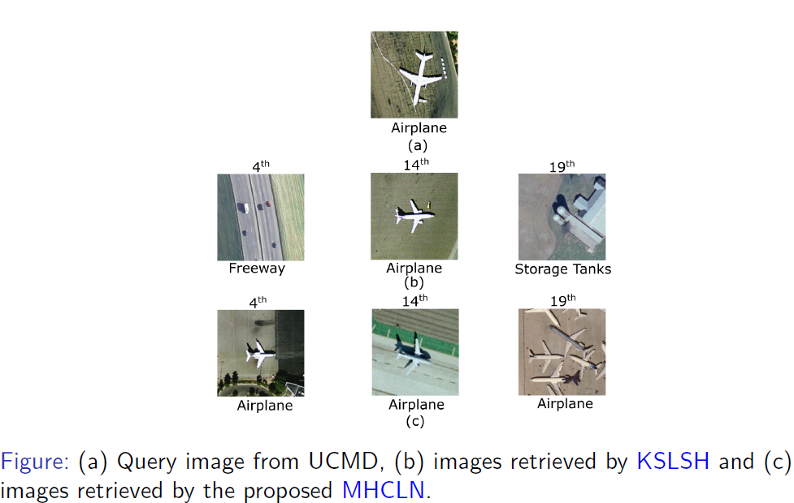
Experimental Results
B. Demir

Slide 26
Conclusion
Accurate and scalable analysis and exploitation of big data in RS is a very important topic both from the methodological and the application perspective.
The presented methods are particularly effective for large scale retrieval problems, where scalability problems becomes crucial.
Methodological challenges related to the properties of satellite data require the development of a new generation of RS image search/retrieval techniques.
Methods robust to availability of the limited annotated training data and multi-modal image search and retrieval algorithms are necessary.
B. Demir

Slide 27

Accurate and Fast Discovery of Crucial Information for
Observing Earth from Big EO Archives
http://bigearth.eu/
B. Demir

